Slide 1
Laboratory:
Customized Embedded Processor Design
Sajjad Hussain, Dr. Lars Bauer, Prof. Dr. Jörg Henkel

Slide 2
ASIPs: efficiency vs. flexibility
“Hardware solution”
ASIC:
- Non-programmable,
- highly specialized
The best performance
The highest development cost
Only reasonable for high volume products
ASIP
(extensible
processor)
- instruction extension/definition
“efficiency”: MIPS/$, MHz/mW, MIPS/area, …
- parameterization
inclusion/non-inclusion of
functionality/devices
General purpose
processor
“Software
solution”
Flexibility, 1/time-to-market, …
src: Henkel “Design and Architectures for Embedded Systems (ESII)”

Slide 3
ASIPs: efficiency vs. flexibility
“Hardware solution”
ASIC:
- Non-programmable,
- highly specialized
ASIP
(extensible
processor)
- instruction extension/definition
“efficiency”: MIPS/$, MHz/mW, MIPS/area, …
- parameterization
Extremely flexible
Bad performance
inclusion/non-inclusion of
functionality/devices
General purpose
processor
“Software
solution”
Flexibility, 1/time-to-market, …
src: Henkel “Design and Architectures for Embedded Systems (ESII)”

Slide 4
ASIPs: efficiency vs. flexibility
“Hardware solution”
ASIC:
- Non-programmable,
- highly specialized
ASIP
(extensible
processor)
- instruction extension/definition
“efficiency”: MIPS/$, MHz/mW, MIPS/area, …
- parameterization
inclusion/non-inclusion of
functionality/devices
Optimized for an application
Still flexible, but achieves a better performance
“Software
solution”
General purpose
processor
Flexibility, 1/time-to-market, …
src: Henkel “Design and Architectures for Embedded Systems (ESII)”

Slide 5
ASIP Design Flow
Benchmarking
Profiling
Implementation
Test

Slide 6
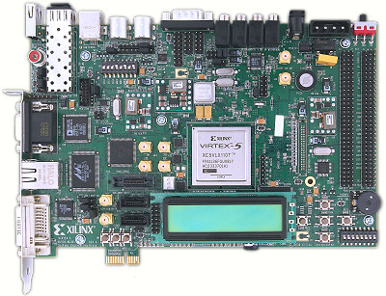
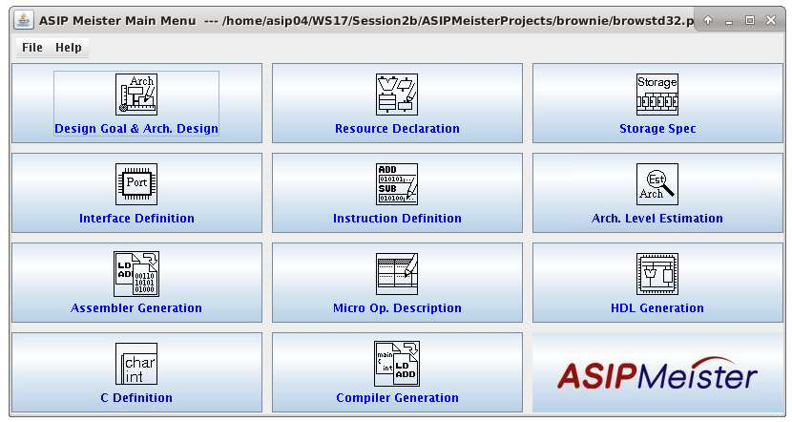
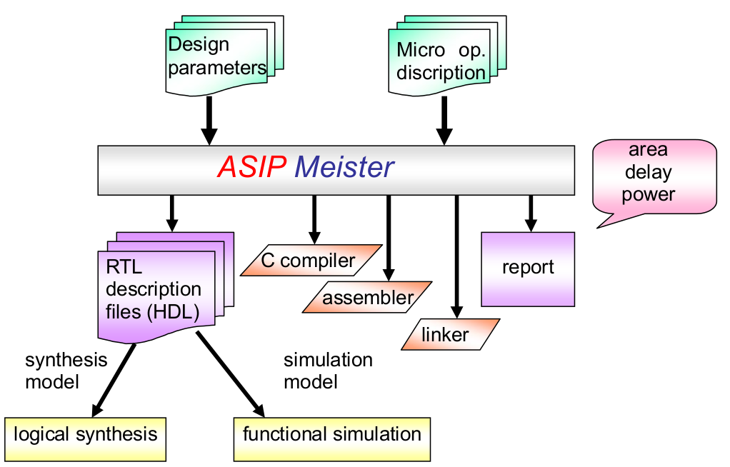
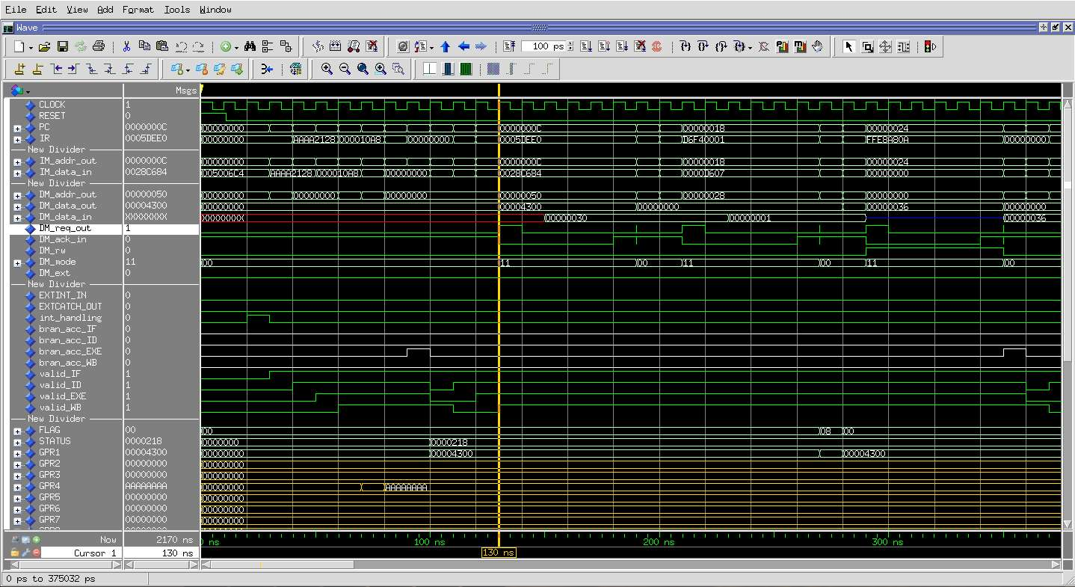
Lab Environments
dlxsim: Instruction Set Simulator adapted for our Processor
ASIPMeister: To create new processor and compiler
Extended GCC compiler: compiler out of an processor architecture description in ASIPMeister.
QuestaSim/ModelSim: hardware simulator for RTL Code
Xilinx Vivado/ISE: Synthesis of RTL Code
XPower: To estimate power consumption
ASIPmeister Software
Virtex-5 FPGA Evaluation Board
ASIPMeister Input and Output
ModelSim Simulation (Signals)

Slide 7
Goal of ASIP Lab
Creating new CPUs with new instructions and implementing these new instructions in Hardware and Software with evaluation and testing
The main goals are:
creating new ASIPs for special applications
benchmark those ASIPs to find out their benefits and drawbacks
and finally to interpret the benchmark results
Lab Structure:
Weekly Sessions: Eight 2-3 hours sessions per week
Lab Groups: Group of 2-3 students to carry tasks
Each group should perform each Week/Session exercises and submit the answers before next session start.

Slide 8
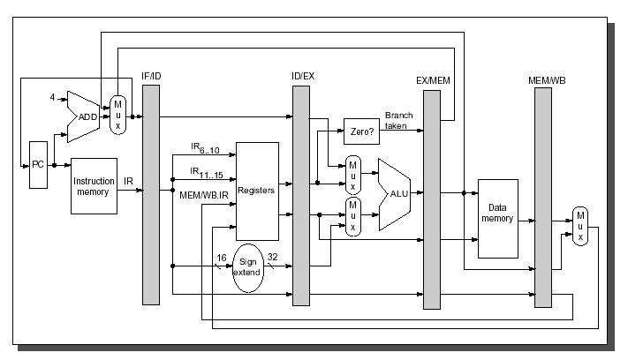
Pipeline Processor
src: Muhammad Shaaban “The DLX Architecture”, lecture on ‘Computer Architecture’

Slide 9
Pipelining

Slide 10
Pipeline Processor Used
Parameters | Architecture
Basic architecture | RISC
Memory architecture | Harvard
Instruction length | 32
Data length | 32
Addressing | Byte address
The number of general-purpose registers | 32
The number of pipeline stages | 4
The number of delayed branch slot | 0
Floating-point unit | N/A
Forwarding | full forwarding
Alignment | 1-byte, 2-byte and 4-byte
Endian-ness | Big Endian
Interrupts | Reset, Internal, External
Brownie STD 32 is a RISC-type pipeline processor architecture.
The Brownie architecture is designed for an easy and fast pipeline processor.
It is a Load-/Store-architecture,

Slide 11
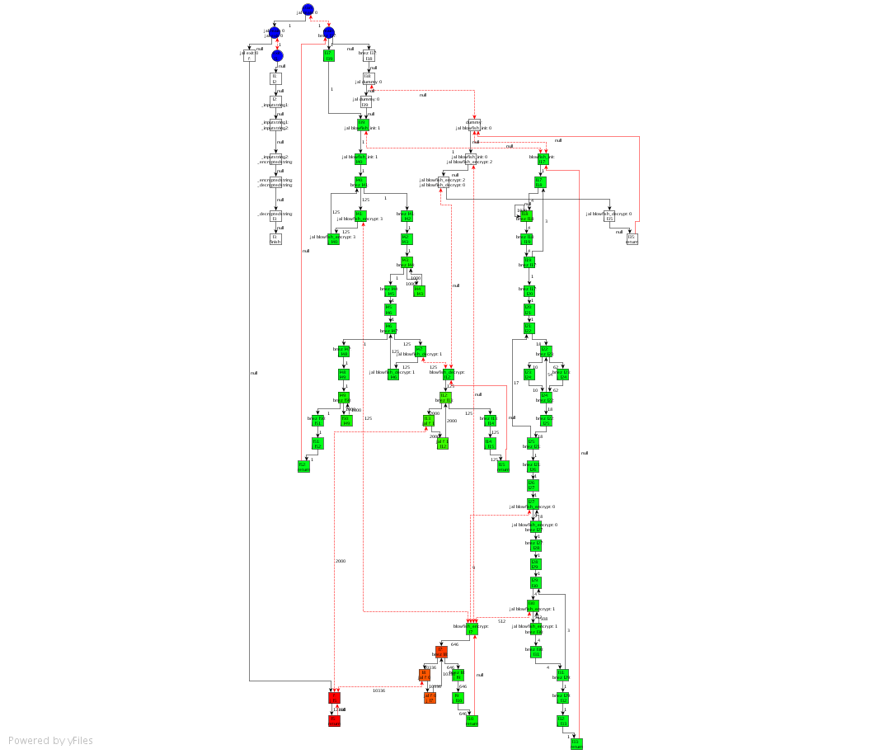

Profiling on Control-Flow Graph
Each node is a Base Block:
The instructions in a Base Block are always executed together
No jumps in a Base Block, except the end
No jump targets in a Base Block, except the beginning
Blowfish with 1 KB input data: Encrypt and Decrypt

Slide 12
Constraints for Designing Custom Instructions
Number of Input-/Output-Values to Custom Instruction
Limited by register file, e.g. 4 read and 2 write ports
‘Forbidden Nodes’, e.g. Load/Store
Convex Graph
Limited Frequency, Area, Power, and/or Energy Budget
An ASIP that consumes more power may consume less energy, if the application terminates much earlier
load

Slide 13
Important Documents
Following is used as reference material. In each session, only the relevant chapters are asked to read. No need to go through all these.
Must Read!!!
Weekly Session Exercise
Optional
Laboratory Script
ASIPMeister Users’ Manual (AM_usersmanual_en.pdf)
ASIPMeister Tutorial (AM_tutorial_en.pdf)
Brownie STD 32 Reference Manual (BrownieSTD32_Spec_en.pdf)
Brownie STD 32 Package ReadMe.txt (README_en.txt)
Using the GNU Compiler Collection (Compiler.pdf)
The GCC Assembler (GCC Assemble.pdf)
The GNU linker (linker.pdf)

Slide 14
Important Directories
/home/asip00/Sessions/SessionX: The lab exercise for each session. For instance; the “Laboratory Script” is placed at Sessions/Session0.
Before each session is started, the corresponding material will be copied to its folder.
/home/asip00/Documents/: The relevant tutorials and manuals for the Lab.
/home/asip00/epp:
AM_tools: ASIPmeister tools to generate custom compiler
ASIPMeisterProjects: a template project
dlxsimbr_Laboratory: DLXIM simulator to be used
mkimg: Lab Makefile and Scripts
StdLib: standard library for I/O

Slide 15
Important Note
Lab computers, software and hardware can be accessed remotely.
Generally, the sessions need to be executed on one of the following Lab PCs:
i80labpc01, i80labpc02, … i80labpc10
ASIPmeister is ALWAYS executed from i80pc57. This PC can be SSH-ed from any of above PCs i.e. i80labpcXX or from your laptop.
FPGA JTAG driver is setup on i80labpc10, and FPGA board can be accessed via this PC only.
For remote/ONLINE access use ssh –X username@i80labpc10.ira.uka.de

Slide 16
Important Note
Due to prevailing condition the lab will be conducted ONLINE
Meetings: Though Zoom (mutually decided in Kick-off)
Lab PCs: Accessed through SSH (Using MobaXterm, X2Go, Putty etc.)
User accounts will be sent to you via email

Slide 17
How to access?
Accessing PC:
Login to i80labpcXX using user@i80labpcXX.ira.uka.uk via MobaXterm.
ssh –X user@i80pc57 and perform all exercises here.
In case you need to implement your application to FPGA, you need to login to i80labpc10, i.e., ssh –X user@ i80labpc10
Accessing Helping Material
/home/asip00/Documents
/home/asip00/Sessions
/home/asip00/epp
Creating recommended directory structure
Create new project directory for each new project
Create new application directory for each new application
To create new project use TEMPLATE_PROJECT.

Slide 18
Recommended Reading for Session-1
For the first session, read the following:
ASIPmeister User Manual
Laboratory Script’s Chapter 1
Laboratory Script’s Chapter 3 (dlxsim; without 3.2.2, 3.2.3 & 3.3.2)

Slide 19
An Example: Application
[…]
for ( ; len > 0 ; len-- ) {
/* Step 1 - get the delta value */
if ( bufferstep ) {
delta = inputbuffer & 0xf;
} else {
inputbuffer = *indata++;
delta = (inputbuffer >> 4) & 0xf;
}
bufferstep = !bufferstep;
/* Step 2 - Find new index value (for later) */
index += indexTable[delta];
if ( index < 0 ) index = 0;
if ( index > 88 ) index = 88;
/* Step 3 - Separate sign and magnitude */
sign = delta & 8;
delta = delta & 7;
/* Step 4 - Compute difference and new predicted value */
/*
** Computes 'vpdiff = (delta+0.5)*step/4', but see comment
** in adpcm_coder.
*/
vpdiff = step >> 3;
if ( delta & 4 ) vpdiff += step;
if ( delta & 2 ) vpdiff += step>>1;
if ( delta & 1 ) vpdiff += step>>2;
if ( sign )
valpred -= vpdiff;
else
valpred += vpdiff;
/* Step 5 - clamp output value */
if ( valpred > 32767 )
valpred = 32767;
else if ( valpred < -32768 )
valpred = -32768;
/* Step 6 - Update step value */
step = stepsizeTable[index];
/* Step 7 - Output value */
[…]
#define signedUnsignedModification 0x8000
#if PRINT_ARRAY
t_print(separator);
t_printHex( (valpred+signedUnsignedModification) & 0xFFFF, 4);
if (printCounter%10==9) separator=",\r\n";
else separator=", ";
printCounter++;
#else
if (printCounter&1)
writeToAudioOutL( (valpred+signedUnsignedModification) & 0xFFFF);
else writeToAudioOutR( (valpred+signedUnsignedModification) & 0xFFFF);
printCounter++;
#endif
}
[…]

Slide 20
An Example: ASIPs
CPU0: The original CPU
CPU1: Optimization for speed
CPU2: Optimization for energy and area

Slide 21
An Example: Benchmarking
Cycles and Execution Time
CPU Area
Maximal Frequency
Power and Energy Consumption

Slide 22
An Example: Conclusions
Optimization Result
CPU1
Obviously much faster
Only execution speed is here consider.
CPU2
Less power consumption but slower
Only one resource ALU is used here.
Almost Same Energy Consumption

Slide 23
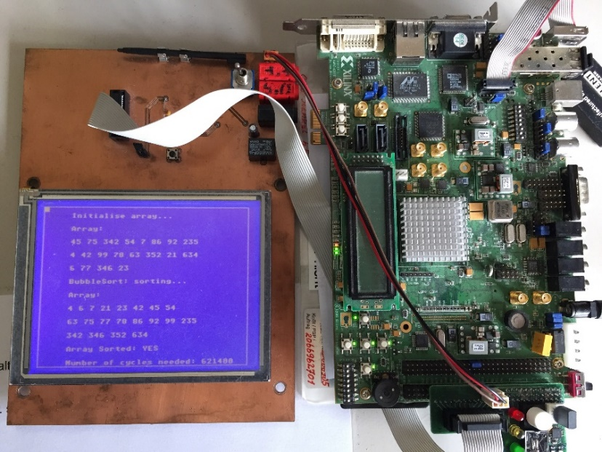
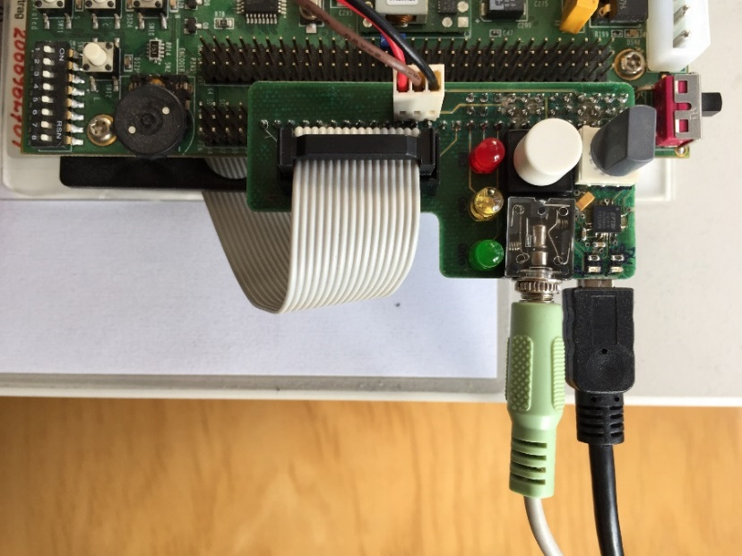
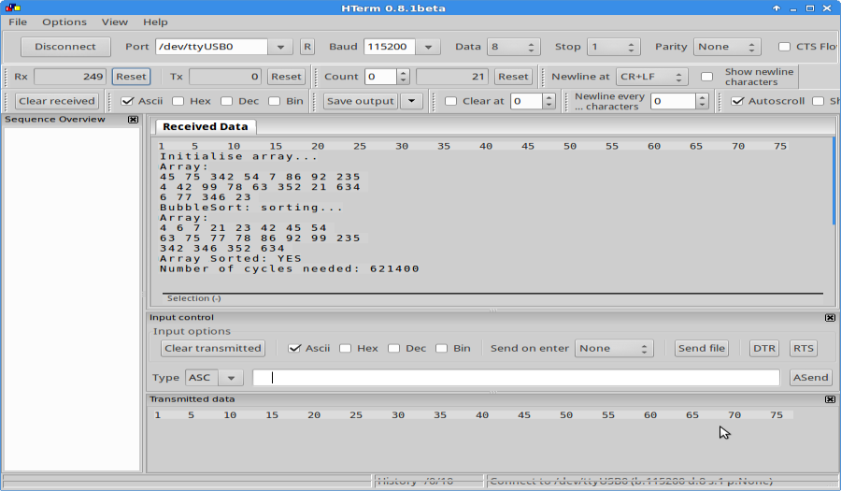
An Example: HW Implementation
ASIP Lab Hardware Virtex-5 Setup
Peripheral Board Connections
CPU Signals (ModelSim Simulation)
Output to UART hterm

Slide 24
Supervisors and the regular meeting
Dr. Lars Bauer
Sajjad Hussain
Regular Meeting: what about Monday 16:00 ?
Questions??

